Slide 1

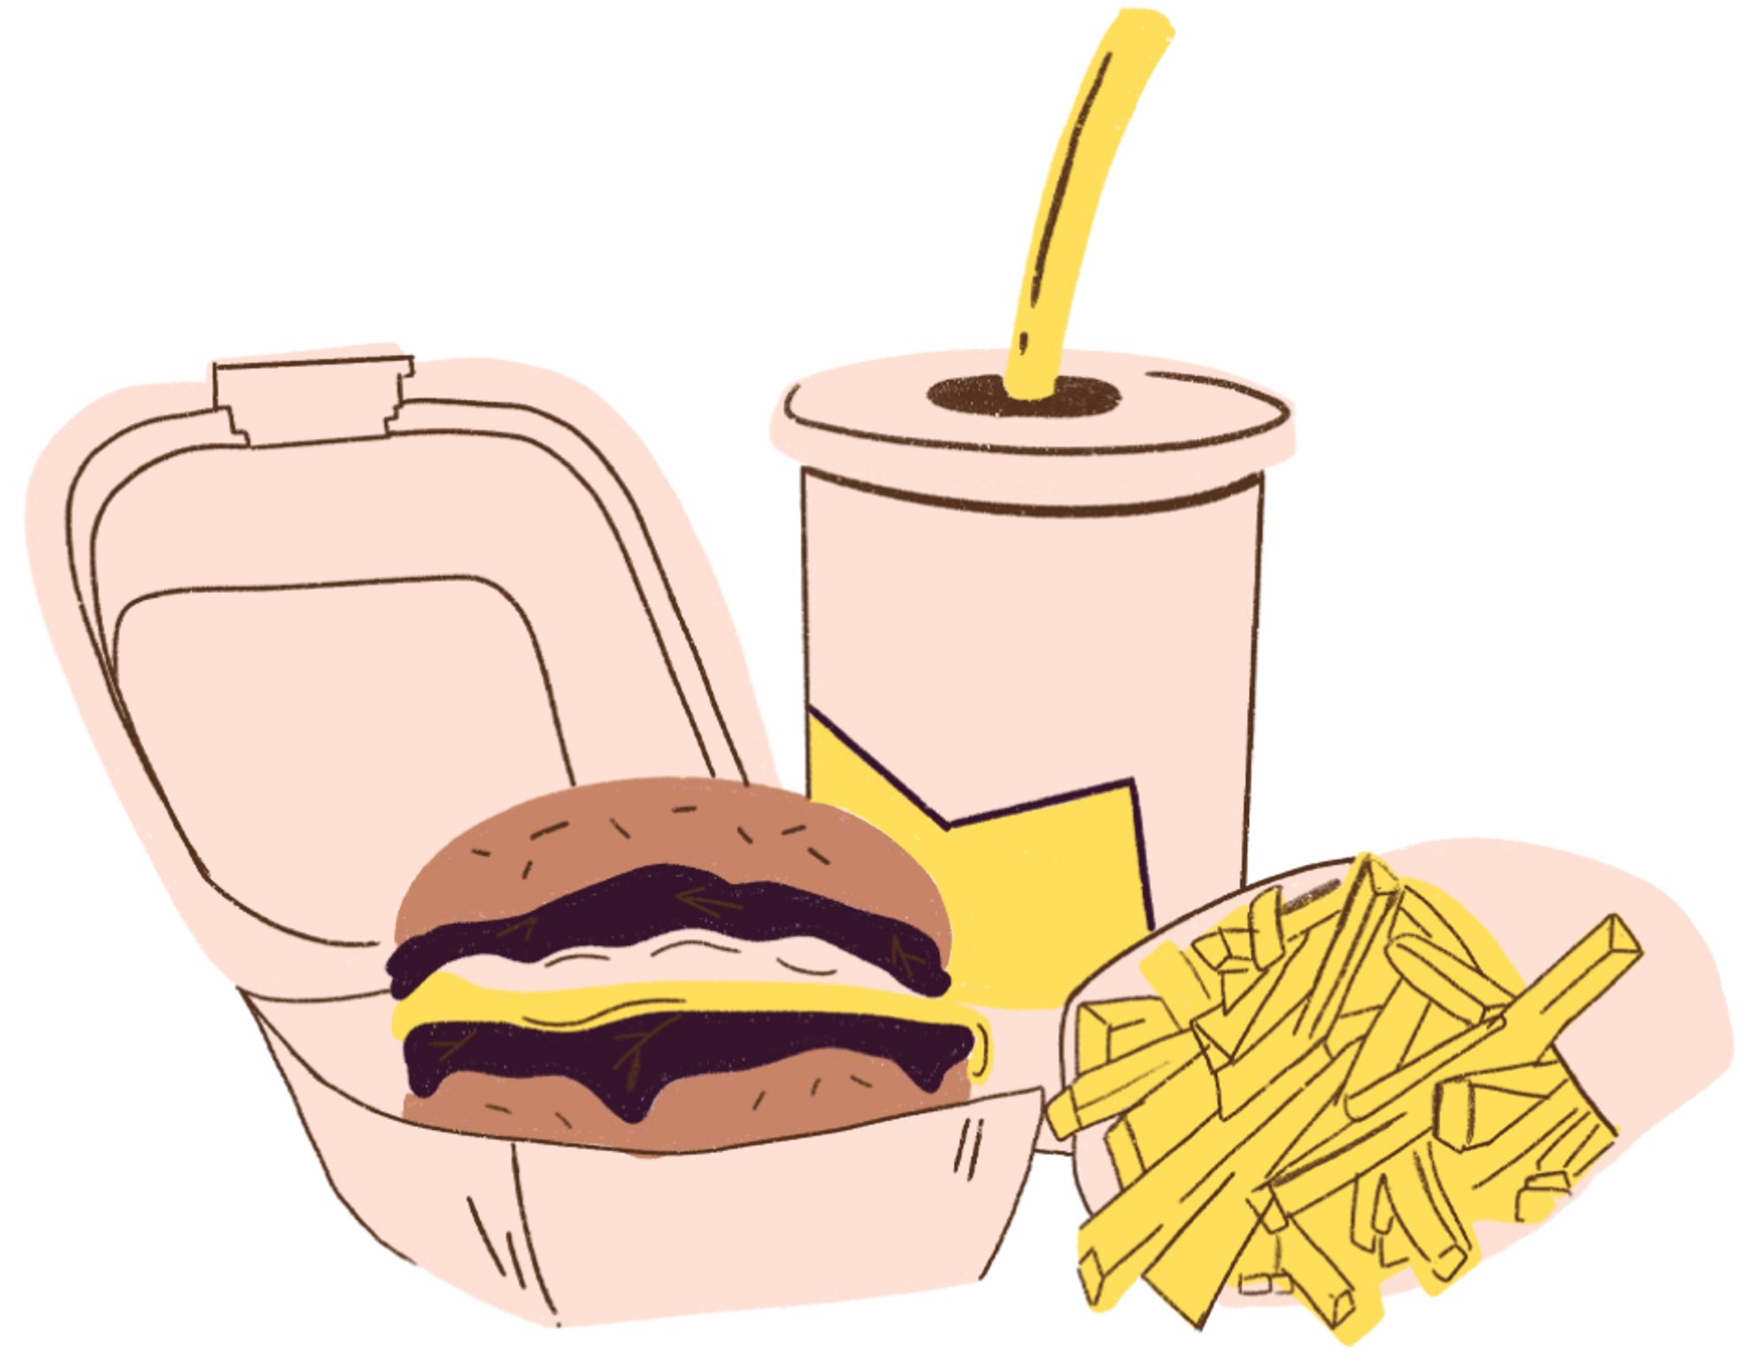

ERGY8031-1
CAPSTONE - Applied Energy Management
CIRCULAR
WASTE-TO-ENERGY SYSTEM FOR FOOD PROCESSING PLANTS
Integrating AD, Biomass Combustion & CHP
Patels Group | Presentation

Slide 2




CONTENT
  Introduction
  Description of Problem
  Objectives
  Proposed design
  Requirements
  Details
  Evaluation of design
  Recomendations

Slide 3


INTRODUCTION
  Generation: 60 tonnes of organic waste every single day!
  Disposal: Methane emissions and waste valuable energy.
  Our plan: A circular waste-to-energy system using AD + Biomass + CHP.
  Our Goal: Convert waste into electricity, heat, and fertilizer and giving mother earth a high five!

Slide 4



PROBLEM IS...
  Facility relies heavily on natural gas for heat and grid electricity for operations.
  Double cost burden: Paying for disposal + paying for fossil fuel energy.
  Current operation does NOT meet sustainability or decarbonization goals.
Meaning, The plant is wasting energy potential while paying heavily for external energy.

Slide 5

OBJECTIVES OF THE PROJECT
  Design an integrated waste-to-energy system
  Renewable electricity (15,000 kWh/day) & Thermal energy (37,000 kWh/day).
  Minimum 60% GHG reduction
  Economic feasibility with a 6.4–9.5 year payback.
  Circular economy principles with digestate fertilizer recovery.
.

Slide 6



PROPOSED DESIGN
SYSTEM COMPONENT
1
2
3
4
Anarobic Digestion
Biomass Combustion
Digestate
CHP
Biogas
Production
Thermal Energy
from Dry waste
Electricity + Heat
Fertilizer for Agriculture

Slide 7

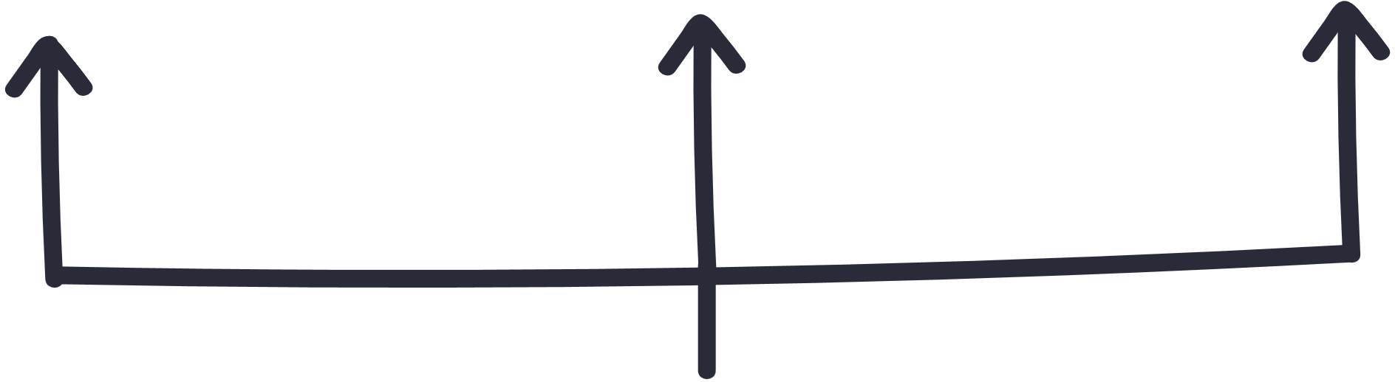
ENERGY OUTPUTS
This combination offsets major portions of the plant’s heat and power demand while creating valuable by-products.
Electricity Production
Thermal Energy Production
Digestate Production
  15,000 kWh/day of renewable electricity generated through CHP
  Significantly reduces dependence on grid electricity
  37,000 kWh/day of usable heat
  Offsets a major portion of natural gas consumption in the plant
  55 tonnes/day of nutrient-rich digestate
  Can be used as fertilizer, supporting agricultural circularity

Slide 8



SUMMARY OF CONSTRAINTS
Performance
Requirement
  Offset 20–30% plant
electricity
  Offset 40–60%
thermal demand
  ≥90% system uptime
Economic Requirements
  CAPEX ≤ $15M
  Payback < 10 years
  IRR > 8%
Environmental Requirements
  ≥40% GHG reduction
  Must comply with Ontario MOECC, CFIA, and CSA codes

Slide 9

DETAILED DESCRIPTION OF THE DESIGN

Slide 10
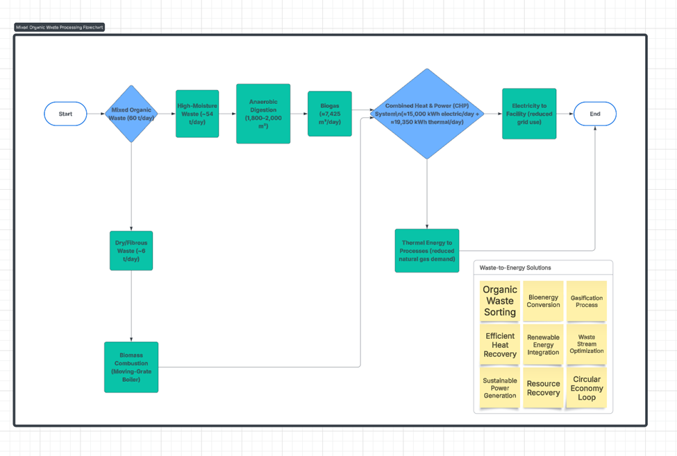

Slide 11
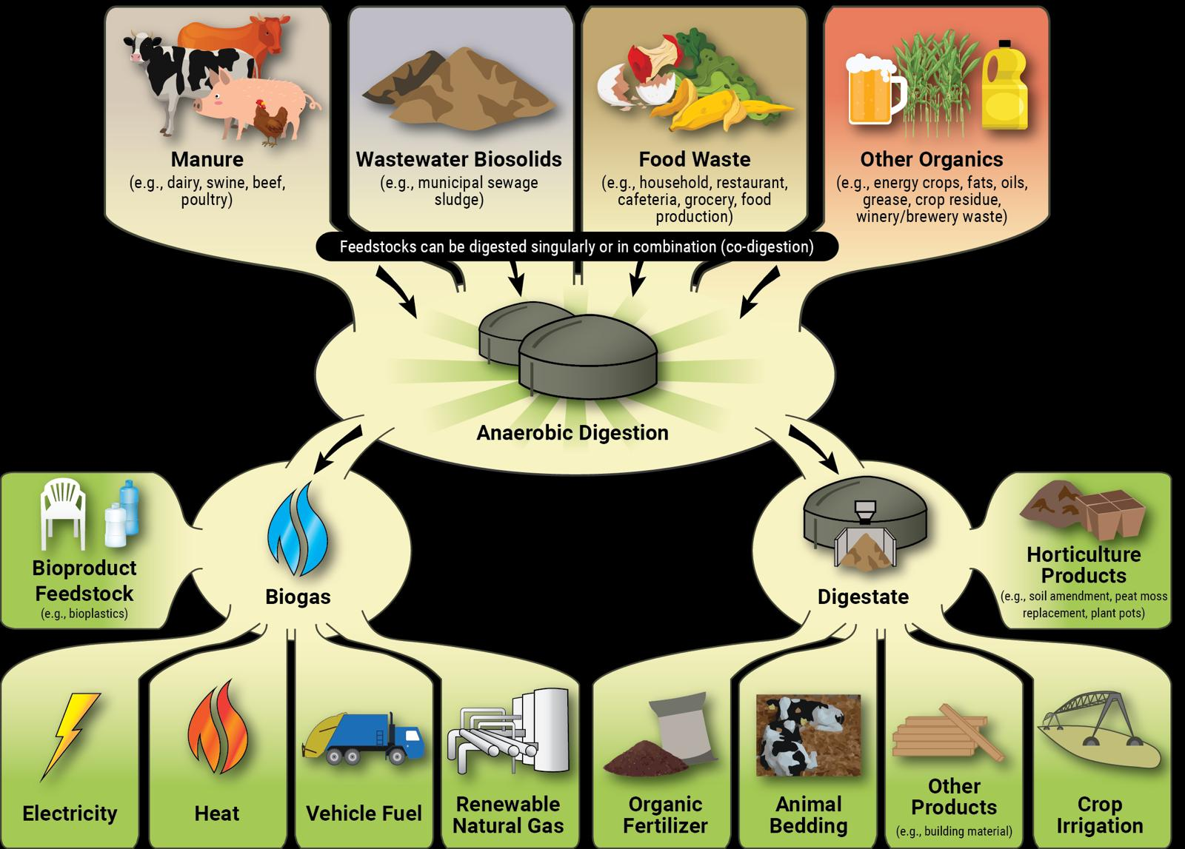

Slide 12


System Integration
  Wet waste → AD
  Dry waste → Biomass boiler
  Biogas → CHP
  Heat loops supply industrial processes
  Digestate → agricultural fertilizer

Slide 13



1.Anaerobic Digestion (AD)
1,800 m³ CSTR digester
Produces 7,425 m³/day biogas, approx. 58% methane
Digestate is separated into solid + liquid fertilizer streams
2. Biomass Combustion
6 tonnes/day of dry fibrous waste
Produces upto 18,000 kWh/day usable thermal energy
3. CHP System
Converts methane into 15,000 kWh/day electricity
Recovers 19,350 kWh/day heat
Powers plant loads + reduces purchased natural gas

Slide 14
EVALUATION OF THE DESIGN

Slide 15

DETAILS
Technical Performance
  Total usable energy: 52,000+ kWh/day
  CHP + biomass meets major plant energy loads
  Technology is fully commercial (TRL 9)
Environmental Impact
  4,000 tonnes CO₂e/year reduction
  47% GHG reduction achieved
  Cuts methane emissions + reduces landfill use

Slide 16
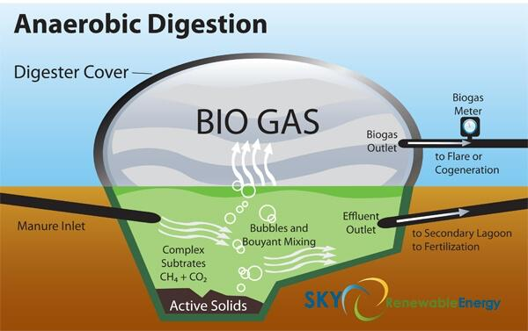

Slide 17
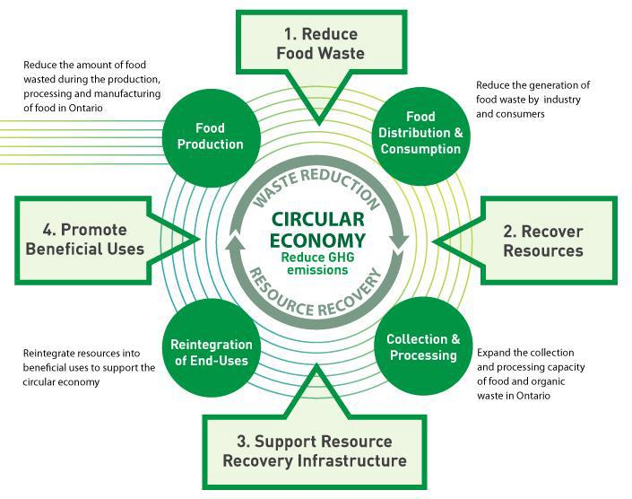

Slide 18
FINANCIALS
  Energy savings: $2.17M/year
  Carbon credits: $0.38–0.62M/year
  Net cash flow: $1.55–1.79M/year
  Payback: 6.4–9.5 years
  IRR: 11.8%

Slide 19
RECOMMENDATIONS
  Proceed to detailed engineering design phase
  Conduct waste characterization testing
  Secure carbon credit revenue contracts
  Partner with farms for digestate reuse
  Begin MOECC permitting early

Slide 20
CONCLUSION
  The system converts 60 t/day waste into renewable energy effectively.
  Delivers 15,000 kWh electricity + 37,000 kWh heat/day reliably.
  Achieves 47% emission reduction and strong financial returns.
  Provides a scalable, future-proof circular energy model for the food processing industry.

Slide 21

THANK YOU

